Slide 1
Recommender Systems

Slide 2
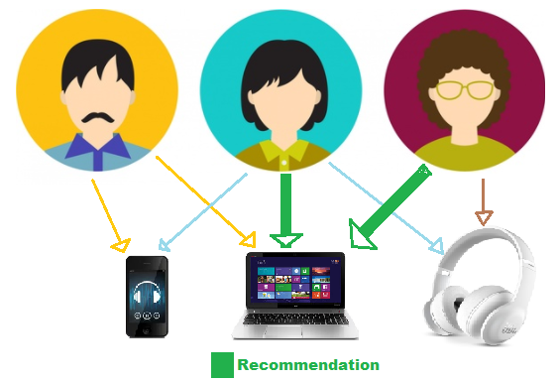
Recommender System
It is an information filtering system that seeks to predict the rating or preference a user would give to an item.
Recommender systems are systems that help users discover items they may like.

Slide 3
Purpose of Recommender System
On the Internet, where the number of choices is overwhelming, there is need to filter, prioritize and efficiently deliver relevant information in order to alleviate the problem of information overload, which has created a potential problem to many Internet users. Recommender systems solve this problem by searching through large volume of dynamically generated information to provide users with personalized content and services.
On a granular level, below are few reasons to use Recommender System:
Value for Money and Time
Easy to pick from huge data
Companies: Analysis of Consumer
Consumer: Variety of options

Slide 4
Real Time Applications of Recommender System
Recommender systems have become increasingly popular in recent years, and are utilized in a variety of areas including movies, music, news, books, research articles, search queries, social tags, and products in general.
When you read some news, watch a movie on Netflix, or simply by something on Amazon you will get some messages like:
You will also probably like this 4. Frequently bought together
Products related to this item 5. Customers who bought this item also bought
Because you have seen X you might also like Y 6. Recommended for you

Slide 5

Utility Matrix
Users have preferences for certain items, and these preferences must be teased out of the data. The data itself is represented as a utility matrix, giving for each user-item pair, a value that represents what is known about the degree of preference of that user for that item.
Below is an Utility Matrix, which represents users ratings of movies on a 1–5 scale, with 5 the highest rating. Blanks represent the situation where the user has not rated the movie. The movie names are HP1, HP2, and HP3 for Harry Potter I, II, and III, TW for Twilight, and SW1, SW2, and SW3 for Star Wars episodes 1, 2, and 3. The users are represented by capital letters A through D.
The goal of a recommendation system is to predict the blanks in the utility matrix.

Slide 6
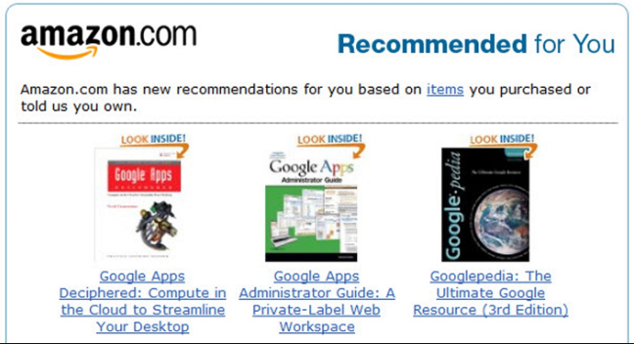

Companies
Some of the companies which are using Recommender Systems are:
Amazon 2. ebay

Slide 7
Types of Recommender System
Three types of Recommender Systems:
Content-Based Systems
Collaborative Filtering
Hybrid Filtering

Slide 8
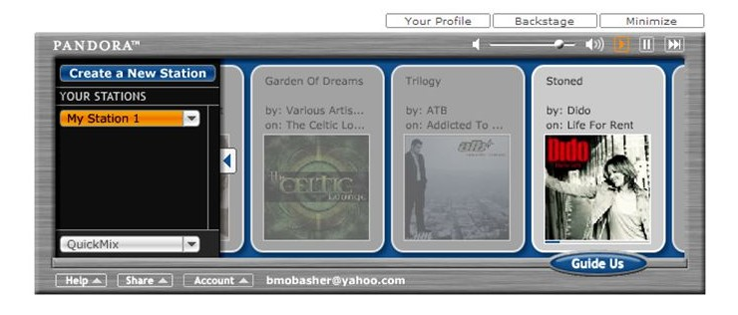
Content-Based Systems
Content based filtering methods are based on the item’s description and the user’s profile.
Recommends items similar to those liked by the user in the past.
Here the similarity is based upon the metadata of the Item.
Example:PANDORA

Slide 9
Item Profiles
In a content-based system, we must construct for each item a profile, which is a record or collection of records representing important characteristics of that item.
In simple cases, the profile consists of some characteristics of the item that are easily discovered. For example, consider the features of a movie that might be relevant to a recommendation system.
1. The set of actors of the movie. Some viewers prefer movies with their favorite actors.
2. The director. Some viewers have a preference for the work of certain directors.
3. The year in which the movie was made. Some viewers prefer old movies; others watch only the latest releases.

Slide 10
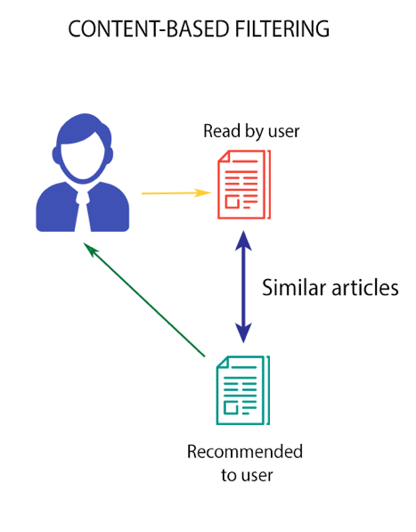
User Profiles
User Profile Describes the types of items user likes.
Compares the items to user profile and determine what to recommend.
It is used to provide personalized Recommendations.
In a simple way it's the weighted average of the rated item profiles.

Slide 11
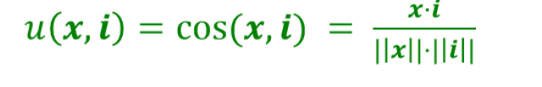
Recommendations using Item &User Profiles
With profile vectors for both users and items, we can estimate the degree to which a user would prefer an item by computing the cosine distance between the user’s and item’s vectors.
For Given User Profile x and Item Profile i,the predictions are calculated as
Thus, the highest recommendations (lowest cosine distance)

Slide 12
Classification Algorithms
Another approach to a recommendation system using item profiles and utility matrices is to treat the problem as one of machine learning algorithms
Regard the given data as a training set, and for each user, build a classifier that predicts the rating of all items.
A decision tree is a collection of nodes arranged as a binary tree.
The leaves render decisions and each interior node is a condition on the objects being classified.
We start at the root to classify an item and apply the predicate at the root to the item. If the predicate is true, go to the left child. If it is false, go to the right child. Repeat the same process at the node visited, until a leaf is reached. That leaf will classify the item as liked or not.
Construction of a decision tree requires selection of a predicate for each interior node. There are lots of ways to pick the best predicate, but they all try to arrange it so one of the children gets all or most of the positive examples in the training set and the other child gets all or most of the negative examples.

Slide 13
Algorithm | Pros | Cons
Decision Trees | easy to interpret visually when the trees only contain several levels Can easily handle qualitative (categorical) features Works well with decision boundaries parallel to the feature axis | prone to overfitting possible issues with diagonal decision boundaries
Logistic Regression | low variance provides probabilities for outcomes works well with diagonal (feature) decision boundaries | high bias
Random Forest | De correlates trees important when dealing with multiple features which may be correlated reduced variance (relative to regular trees) | Not as easy to visually interpret
Naive Bayes | Computationally fast Simple to implement üWorks well with high dimensions | Relies on independence assumption and will perform badly if this assumption is not met

Slide 14
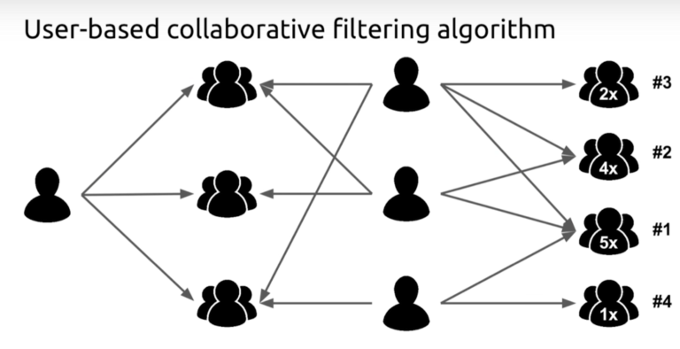
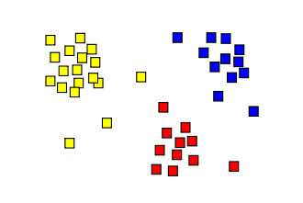
Collaborative Filtering
Rather than focusing on the features of items like in Content-Based systems, this focuses on the similarity of user ratings. Essentially, the goal here is to find users or items that are similar to each other and recommend based on this similarity. In this way, doesn’t require detailed about the items recommended. This is called collaborative filtering. One way to get a rough visual idea about building collaborative filtering is to picture different clusters of similar users and who are assumed to share similar preferences in items.
https://neo4j.com/blog/collaborative-filtering-creating-teams/

Slide 15





Examples

Slide 16
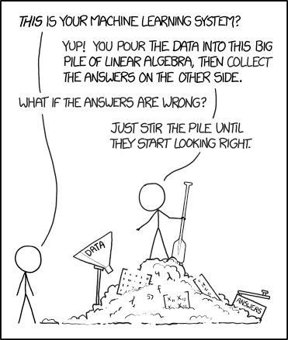
In Practice
There are several different popular methods of collaborative filtering.
Using vector math to measure distance
By using a distance measure such as Jaccard and Cosine, the similarity of two different vectors (users or items) can be calculated.
Normalizing and rounding the data may substantially increase the results.
Using a clustering algorithm
Due to the duality of similarity and sparse data, clustering algorithms such as KNN and Hierarchical clustering are great tools that can be used to segment users and items.
Other algorithms
Because collaborative filtering is so broad in scope, many machine learning algorithms can fall under collaborative filtering. Examples include bayesian networks, latent semantic models, and markov decision process,
https://xkcd.com/1838

Slide 17
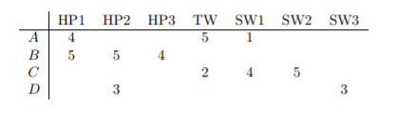
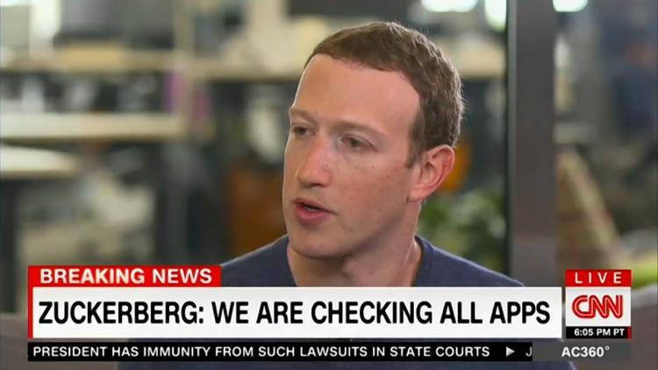
Challenges with Collaborative Filtering
Sparse information
Because information in the utility information can be sparse, collaborative filtering may have few data points in for rarer items. In order to make recommendations, most methods must predict a users preference on many different items.
Accounting for a person’s unique taste
Take for example a music recommendation system. Two people may listen to electronic music and are consequently grouped together. However one user enjoys classical music, while the other does not. Here, a content-based system might be more ideal.
Privacy
For a good collaborative filtering, a lot of data is needed. For example, Facebook, has collected texts, calls, messages, history, photos and other private information about users. This information is then used for collaborative filtering and also sold to corporations. Many users may consider this an invasion of privacy.

Slide 18
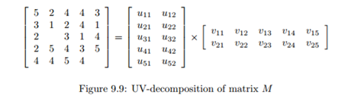
UV-Decomposition
Consider movies as a case in point. Most users respond to a small number of features; they like certain genres, famous actors or actresses that they like, even a few directors.
If we start with the utility matrix M, with n rows and m columns (i.e., there are n users and m items), then we might be able to find a matrix U with n rows and d columns and a matrix V with d rows and m columns, such that UV closely approximates M in those entries where M is non-blank.
If so, then we have established that there are d dimensions that allow us to characterize both users and items closely. We can then use the entry in the product UV to estimate the corresponding blank entry in utility matrix M. This process is called UV-Decomposition of M.

Slide 19
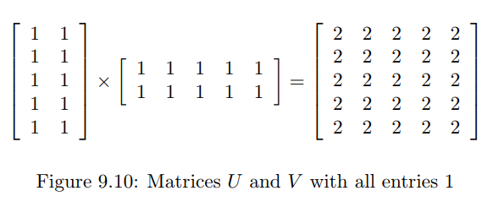
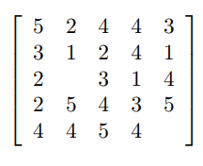
Root-Mean-Square Error
A measures of how close the product UV is to M.
Calculating root-mean-square error (RMSE):
Sum, over all non blank entries in M the square of the difference between that entry and the corresponding entry in the product UV.
Take the mean of these squares by dividing by the number of terms in the sum.
Take the square root of the mean.
Matrix M

Slide 20
Incremental Computation of a UV-Decomposition
Finding the UV-decomposition with the least RMSE involves starting with some arbitrarily chosen U and V , and repeatedly adjusting U and V to make the RMSE smaller.
We shall consider only adjustments to a single element of U or V , although in principle, one could make more complex adjustments.
Whatever adjustments we allow, in a typical example there will be many local minima – matrices U and V such that no allowable adjustment reduces the RMSE.
Unfortunately, only one of these local minima will be the global minimum – the matrices U and V that produce the least possible RMSE.
To increase our chances of finding the global minimum, we need to pick many different starting points, that is, different choices of the initial matrices U and V.

Slide 21
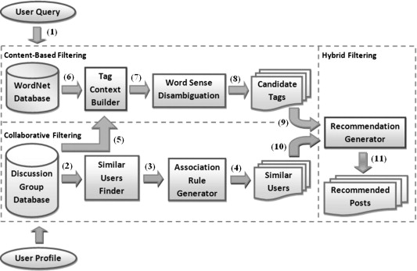
Hybrid Filtering
Generation of candidate set using content
Ranking of candidates using collaborative

Slide 22
Thank you!

